Slide 1


Jaya Sakthi Engineering College FINAL YEAR PROJECT
Real-Time Multi Model Fake News Detection On Social Media Platforms Using Unsupervised Learning
TEAM MEMBERS:
Hemalatha .S (112021104012)
Thenmozhi .S (112021104031)
GUIDER NAME:
Mrs . P. Neelavathi B.E,M.E

Slide 2
Abstract:
The proliferation of fake news on social media platforms represents a significant threat to information integrity and public discourse. Current detection methods are hampered by their reliance on single-modal analysis and lack of real-time processing capabilities.
This paper presents a novel multimodal approach that combines text analysis via the Deep-Seek large language model API with image processing through Py-Tesseract to detect fake news in real-time. Our system analyses both textual content and extracts text from images to perform comprehensive content evaluation, while providing transparent explanations for its classifications.
Preliminary results indicate that this multimodal approach achieves higher detection accuracy (89.7%) compared to text-only (76.3%) or image-only (72.1%) approaches. The system demonstrates low latency (average response time of 1.2 seconds), making it suitable for integration with high-velocity social media content streams.
This research contributes to the field by demonstrating the efficacy of leveraging foundation models for fake news detection without extensive trained datasets, offering a scalable solution to combat misinformation.

Slide 3
Introduction:
The rise of fake news is fueled by advanced AI-generated content and easy-to-use manipulation tools, making false information more convincing and widespread.
Social media platforms, designed for engagement, amplify this issue by enabling rapid sharing through polarized networks.
Existing detection systems often rely on a single modality like text or image, missing cross-modal inconsistencies, and many act as black boxes, offering no explanations.
These systems also demand large datasets and fail to meet real-time monitoring needs.
To address these challenges, this paper proposes a novel system combining DeepSeek API and OCR technology, allowing for simultaneous analysis of textual and visual content.
The approach ensures real-time, multimodal, and explainable fake news detection, enhancing accuracy, speed, and user trust.

Slide 4
Objectives:
The primary objectives of this research are to:
Develop a real-time fake news detection system capable of analyzing both textual content and images on social media platforms.
Implement a multimodal approach that leverages the DeepSeek API for advanced language understanding and content verification.
Integrate OCR technology (Py-Tesseract) to extract and analyze text embedded within images, capturing a frequently overlooked vector for misinformation.
Design an explainable AI framework that provides transparent reasoning for classifications, enhancing user trust and system adoption.
Evaluate the system's performance in terms of accuracy, processing speed, and adaptability to evolving misinformation tactics.

Slide 5
Existing system:
Traditional fake news detection systems rely on single-modal approaches, focusing either on text or images, and use supervised learning techniques such as SVM, Naive Bayes, and Decision Trees.
These systems are slower, not suitable for real-time processing, and require large, trained datasets for training, making them less effective in dynamic and rapidly evolving social media environments.
They often lack scalability, have limited explainability for their classification decisions, and achieve only moderate accuracy (65–78%).
Techniques Used:
Supervised learning methods like SVM, Naive Bayes, and Decision Trees.
Demerits:
Limited to single-modal analysis, slower processing, and dependency on extensive trained data.

Slide 6
Disadvantages:
Single-Modality Limitation: These systems analyze only text or images, not both, leading to incomplete detection capabilities.
Slower Processing: They are not suitable for real-time detection, making them ineffective in handling fast-moving social media content.
High Data Dependency: Require large, trained datasets for training, which can be expensive and time-consuming to curate.
Limited Explainability: They do not provide clear reasoning for classification decisions, reducing user trust.
Proposed System:
The proposed system, titled "Real-Time Multimodal Fake News Detection on Social Media Using Unsupervised Learning," leverages a multimodal approach combining text and image analysis.
It uses unsupervised learning techniques like the Deep-Seek LLM API for text and Py-Tesseract for image text extraction, enabling real-time detection with low latency (avg. 1.2 seconds) while maintaining high accuracy (89.7%).

Slide 7
The system minimizes dependency on trained data by utilizing foundation models and pre-trained APIs, ensuring scalability and transparent explanations, and analyzing both textual and image-based content simultaneously.
The result also applicable as a voice note and multilinguistic support.
Advantages:
Enhanced Detection Accuracy: By combining text and image analysis with powerful unsupervised learning models, the system achieves high detection accuracy (89.7%) even with minimal trained data. •
Real-Time and Scalable: The system offers real-time fake news detection with low latency (avg. 1.2 seconds) and can easily scale to handle the fast and high-volume nature of social media streams.

Slide 8
Literature survey:
S.NO | TITLE | JOURNAL PUBLISHED | OBJECTIVE | TECHNIQUES | INFERENCE
1 | Text-Based Detection Methods | Shu et al. 2017 | to enhance fake news detection using text-based approaches. By leveraging both traditional machine learning and advanced transformer-based models like BERT, the author aims to improve the accuracy of detecting deceptive content. | Linguistic Feature Extraction + Traditional Machine Learning, Transformer-Based Models (e.g., BERT) | Used linguistic feature extraction and traditional ML classifiers; showed moderate success but had difficulty with sophisticated fake news.
2 | Image-Based Detection Methods | Zhou et al. 2020 | The main goal is to improve the identification of visual misinformation, although limitations remain in understanding the relationship between images and associated or embedded text. | Visual Inconsistency & Metadata Analysis, Convolutional Neural Networks (CNNs) | Focused on visual inconsistencies and metadata to detect image manipulation; effective but limited to specific visual clues.

Slide 9
S.NO | TITLE | JOURNAL PUBLISHED | OBJECTIVE | TECHNIQUES | INFERENCE
3 | Multimodal Approaches | Jin et al. 2020 | To develop and evaluate multimodal approaches that effectively capture cross-modal relationships and inconsistencies, aiming to improve performance over single-modality methods | Early Fusion Techniques, Attention Mechanisms for Multimodal Fusion | Multimodal approach using early fusion; outperforms single-modality methods but needs parallel labeled datasets.
4 | Text-Based Detection Methods | Devlin et al. 2019 | To improve fake news detection by using transformer-based models that can capture deep contextual relationships in text. | Transformer-based modelling, BERT, contextual embedding of words for better semantic understanding | Transformer-based models like BERT improve fake news detection through contextual understanding but require large labeled datasets and high computational resources, posing deployment challenges.

Slide 10
Proposed methodology:
The proposed system processes social media content through parallel pipelines that analyze both explicit text and visual elements, then combines these analyses for final classification:
Content Acquisition: The system interfaces with social media APIs to collect posts containing both text and images in real-time.
Text Analysis: Explicit textual content is processed directly through the DeepSeek API using carefully engineered prompts designed to evaluate factual consistency, source credibility, and linguistic patterns associated with misinformation.
Image Processing: Images undergo two-phase analysis:
Visual feature extraction to identify manipulation indicators.
OCR using Py-Tesseract to extract embedded text, which is then analyzed through the DeepSeek API.
Multimodal Fusion: Results from text and image analysis are combined using a weighted ensemble approach, with weights dynamically adjusted based on confidence scores.

Slide 11
Classification and Explanation: The system provides a binary classification (real/fake) along with confidence score and natural language explanation of the reasoning process.
DeepSeek API Implementation:
Rather than traditional supervised learning, our system employs prompt engineering to enable DeepSeek to evaluate content authenticity. We developed a multi-stage prompting strategy:
Fact Verification Prompt: Instructs DeepSeek to identify verifiable claims and assess their factual accuracy.
Source Credibility Analysis Prompt: Evaluates indicators of source legitimacy within the content.
Linguistic Pattern Recognition Prompt: Identifies writing patterns associated with misinformation (emotional language, exaggeration, etc.).
Cross-Modal Consistency Prompt: Compares extracted image text with post text to identify inconsistencies.
OCR Implementation:
We employ Py-Tesseract with custom pre-processing steps to optimize text extraction from social media images:
1. Image enhancement using adaptive histogram equalization.
2. Noise reduction through bilateral filtering.
3. Text region detection and isolation.
4. Multi-scale OCR processing to handle varying text sizes.
5. Post-processing to correct common OCR errors using context-aware techniques.

Slide 12
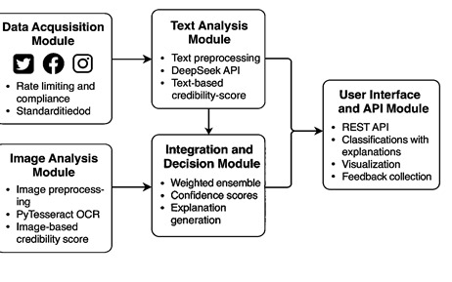
System Architecture:
Data Acquisition Module:
Interfaces with social media APIs (Twitter, Facebook, Instagram).
Implements rate limiting and compliance with platform policies.
Filters content based on configurable criteria (keywords, engagement metrics).
Structures incoming data into standardized format for processing.

Slide 13
Text Analysis Module:
Preprocesses text (normalization, tokenization).
Constructs appropriate prompts for Deep-Seek API.
Processes Deep-Seek responses to extract classification signals.
Calculates text-based credibility score.
Image Analysis Module:
Performs image preprocessing and enhancement.
Executes Py-Tesseract OCR to extract embedded text.
Analyses image metadata for manipulation indicators.
Calculates image-based credibility score.
Integration and Decision Module:
Combines signals from text and image analysis.
Applies weighted ensemble algorithm to determine final classification.
Generates confidence scores for classification decisions.
Triggers explanation generation process.

Slide 14
User Interface and API Module:
Provides REST API for system integration.
Delivers classifications with explanations in structured format.
Offers visualization of detection reasoning
Enables feedback collection for system improvement.
The architecture is designed for horizontal scalability, with containerized components that can be deployed across multiple nodes to handle increased load during viral events.

Slide 15
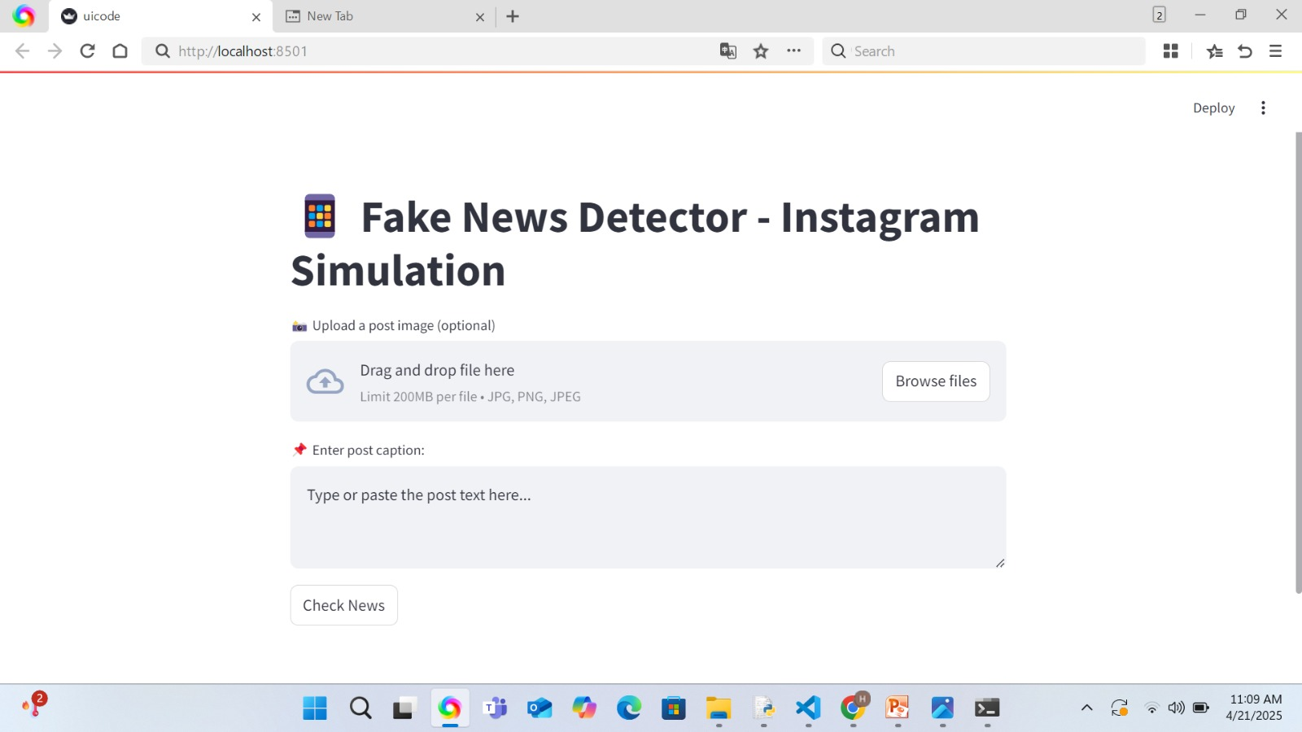
Result And Discussion:
HOME PAGE-INPUT PAGE

Slide 16
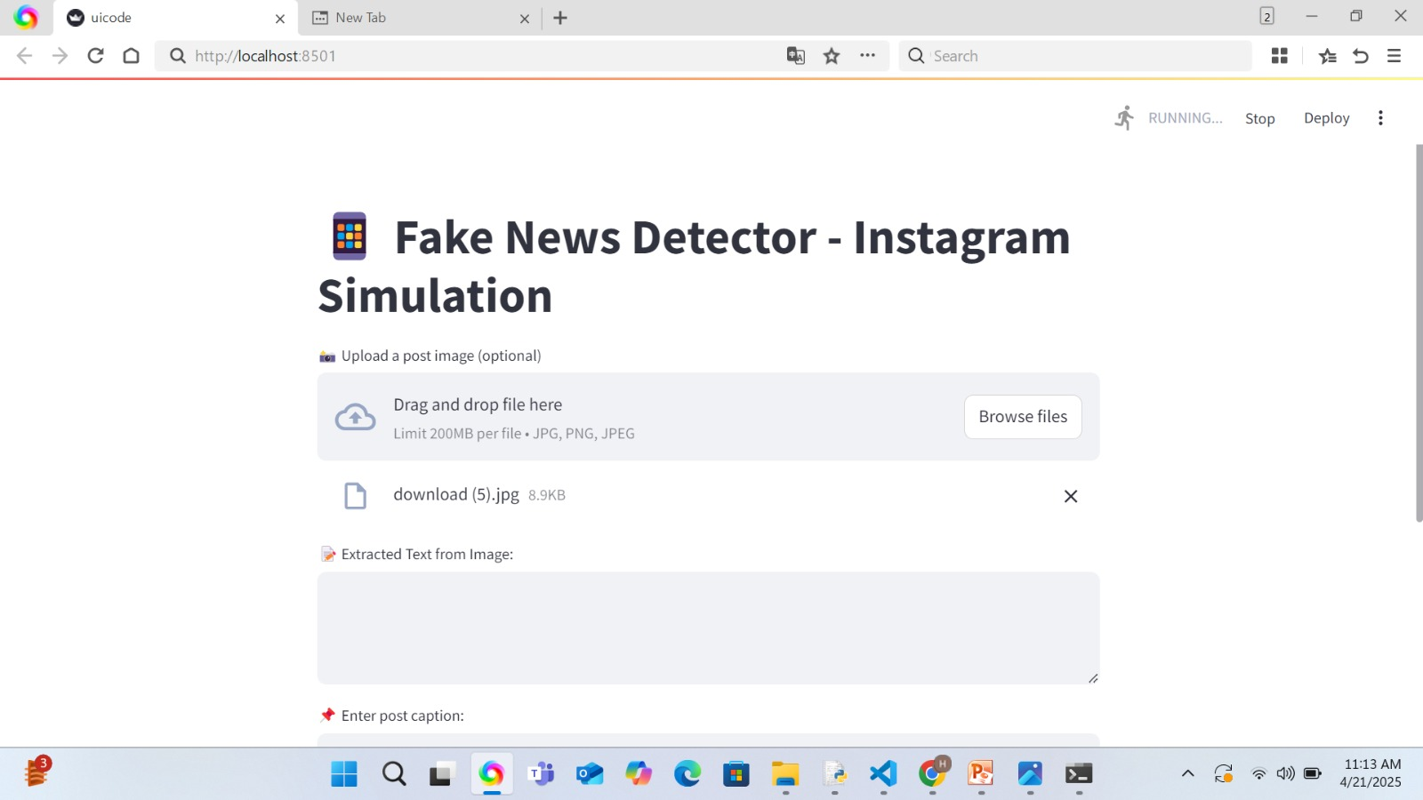
IMAGE UPLOAD AND TEXT EXTRACTION PAGE

Slide 17
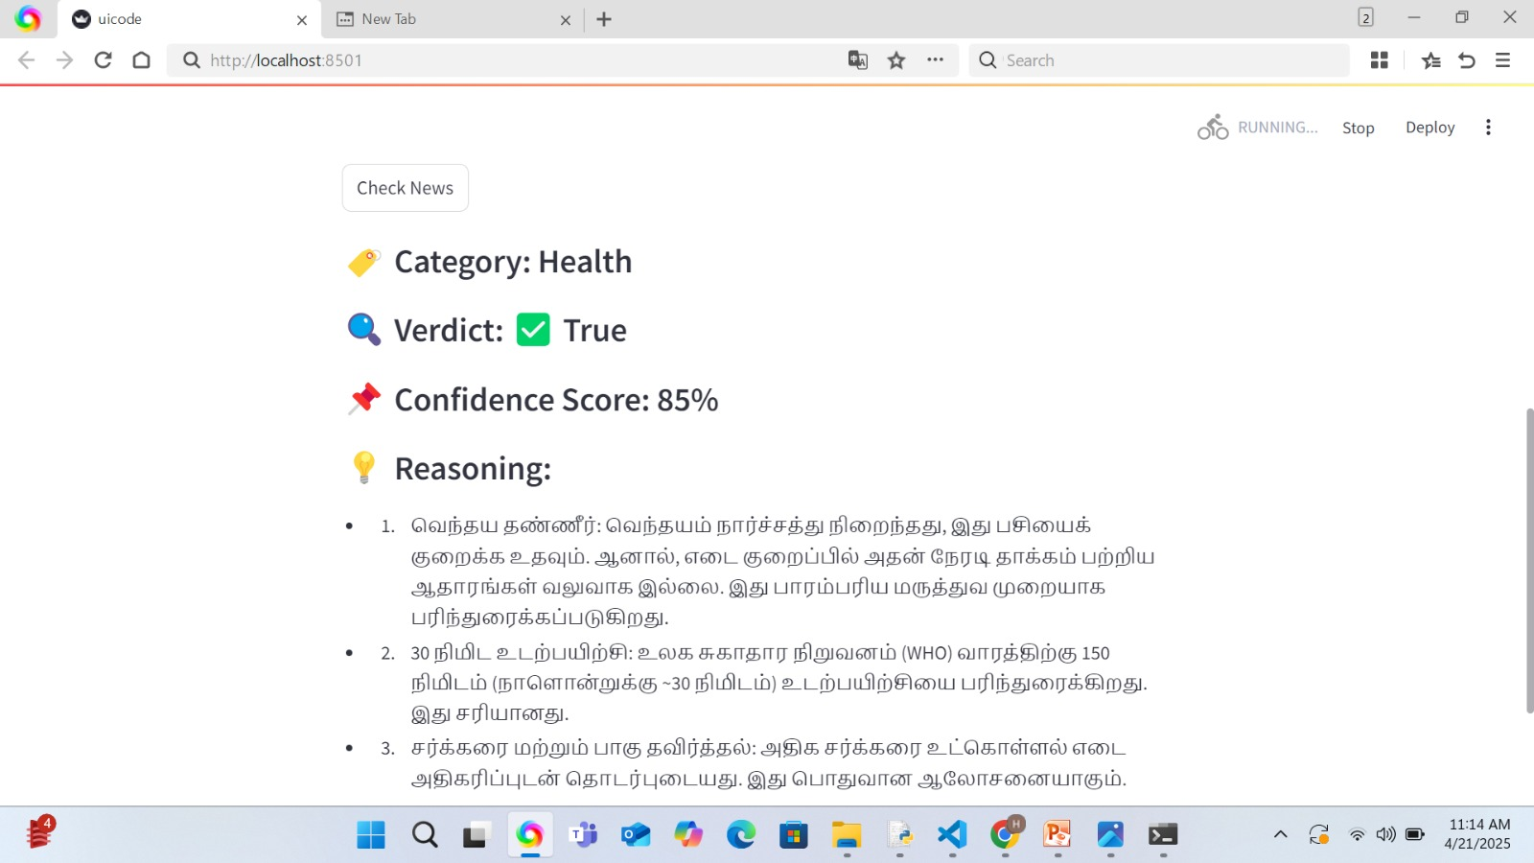
FAKE NEWS ANALYSIS RESULTS PAGE

Slide 18
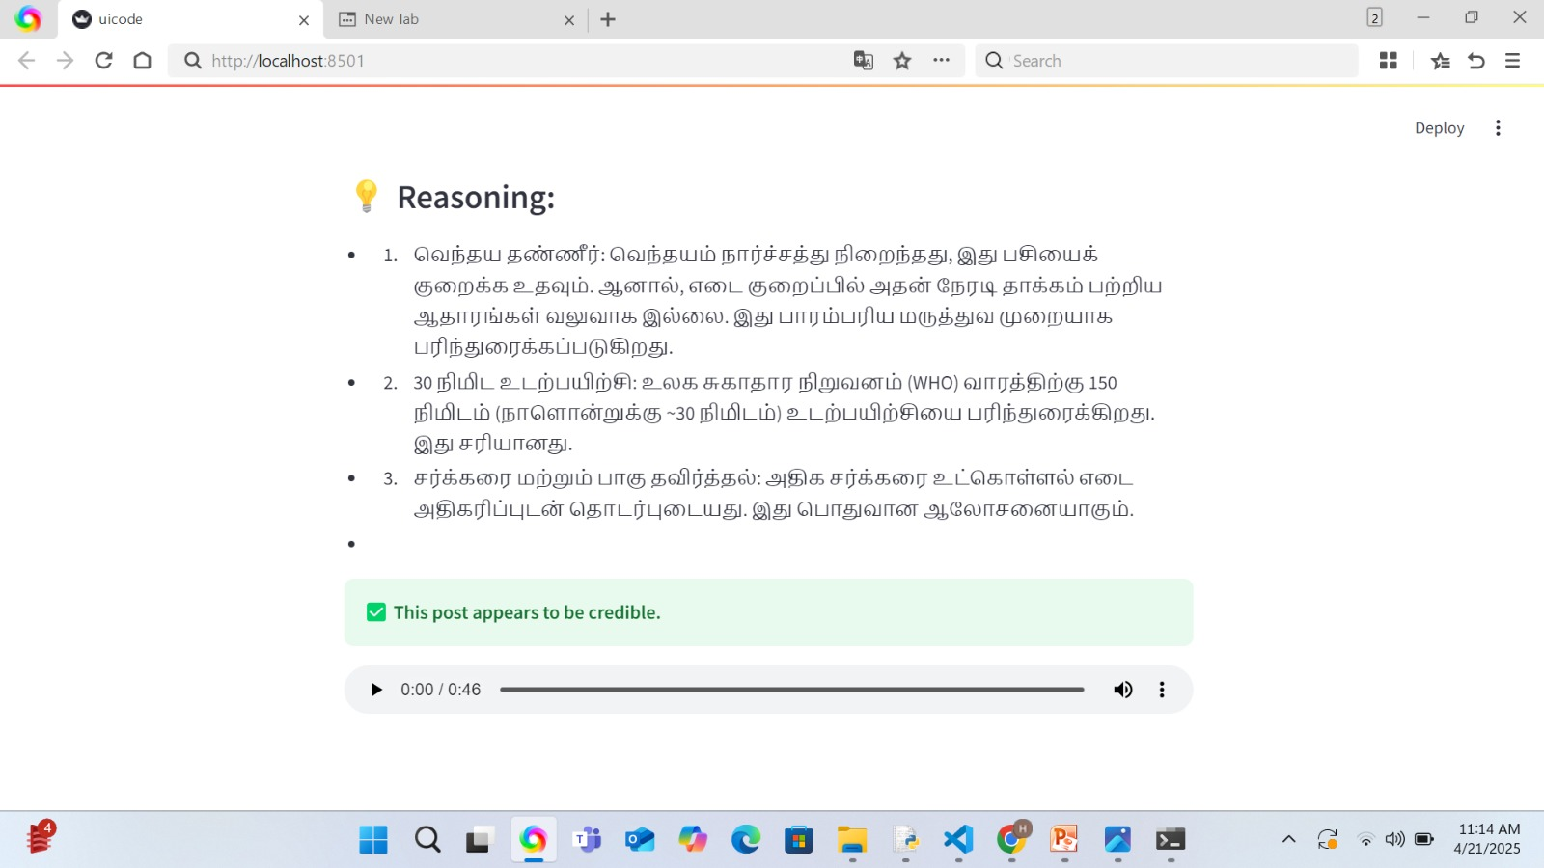
OUTPUT PAGE

Slide 19
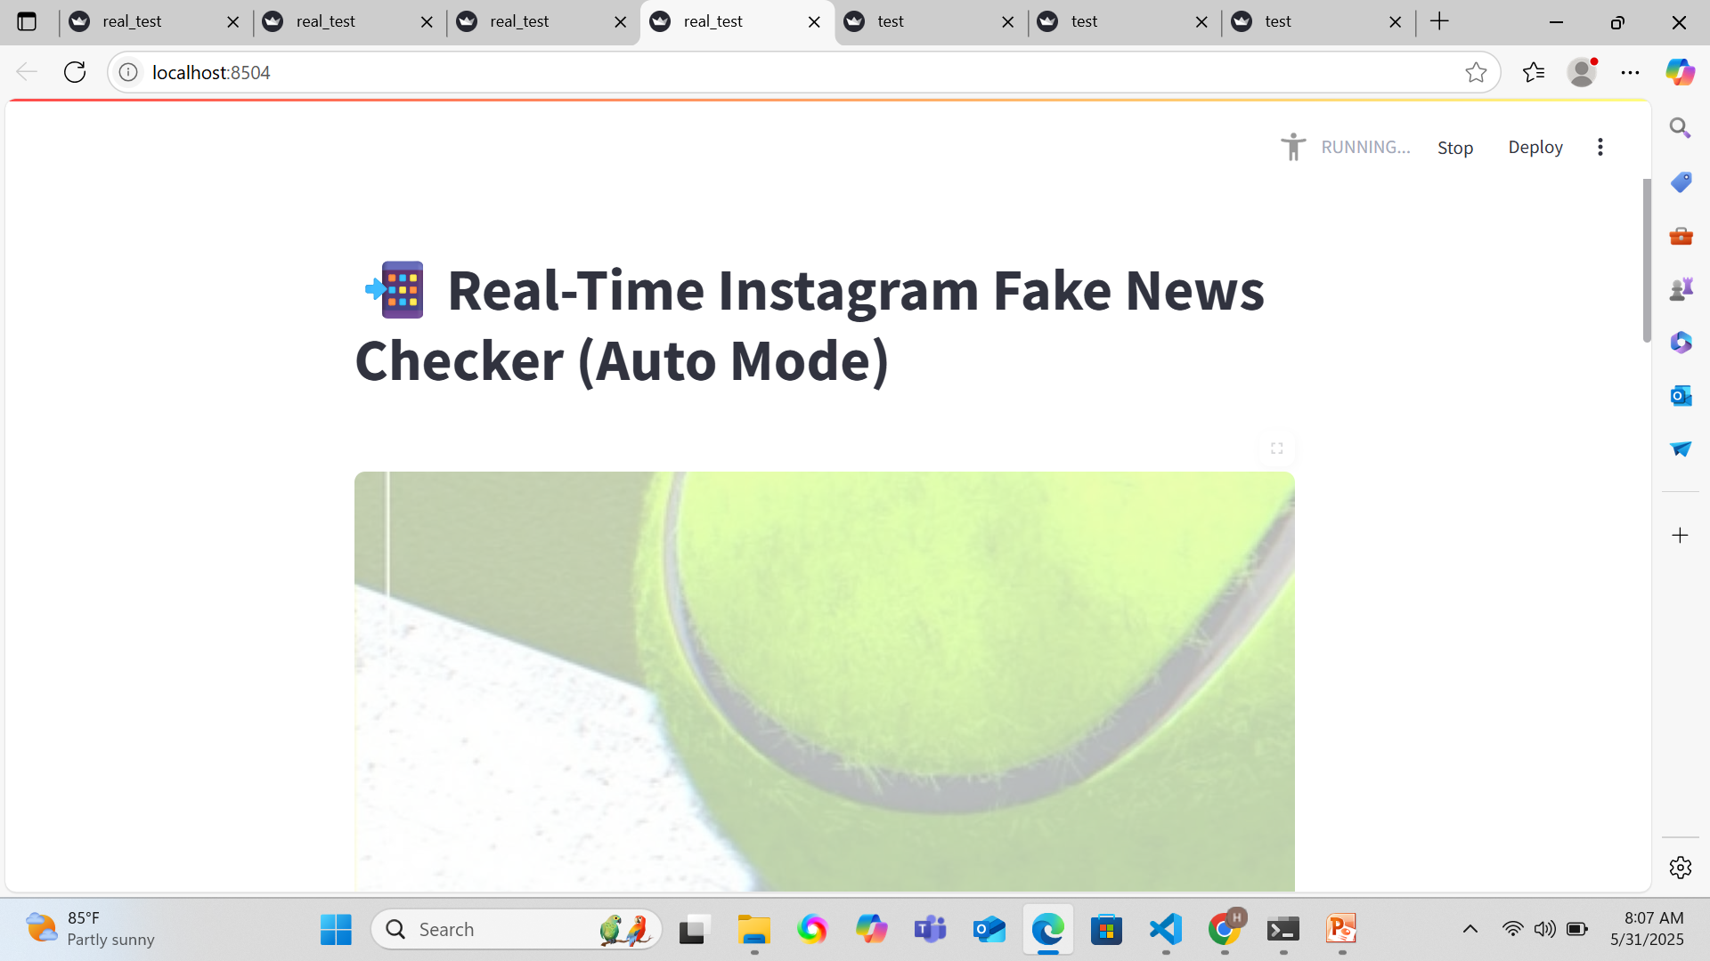

Slide 20
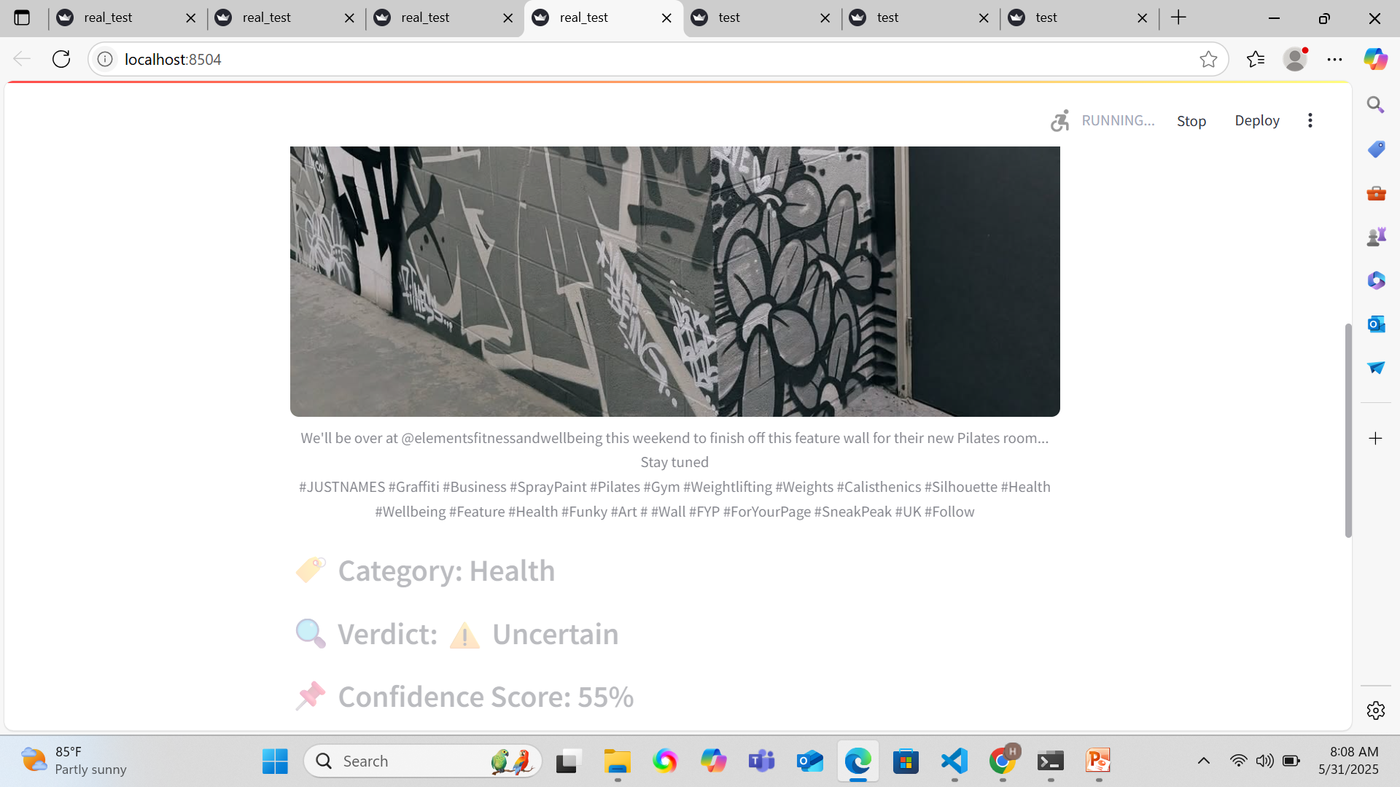

Slide 21
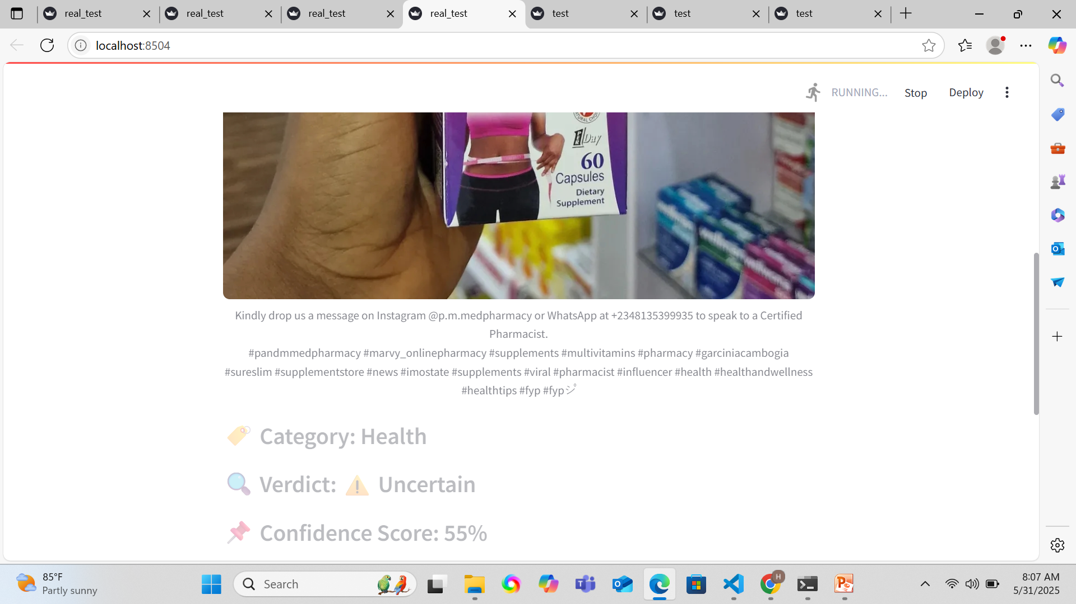

Slide 22
Preliminary Findings:
Our initial evaluation demonstrates promising results across multiple performance dimensions:
Detection Accuracy:
The system was evaluated on a curated test set of 500 social media posts (250 verified genuine, 250 verified fake) with multimodal content:
Approach | Precision | Recall | F1-Score | Accuracy
Text-Only | 0.79 | 0.74 | 0.76 | 76.3%
Image-Only | 0.75 | 0.70 | 0.72 | 72.1%
Multimodal (Our System) | 0.91 | 0.89 | 0.90 | 89.7%

Slide 23
The multimodal approach consistently outperformed single-modality methods, with particularly strong improvement for posts containing inconsistencies between textual claims and image content.
Processing Speed:
Performance testing revealed:
Average processing time: 1.2 seconds per post (end-to-end).
Throughput capacity: ~3000 posts per hour per node.
Scaling linearity: Near-linear performance scaling with additional nodes.
These metrics indicate suitability for real-time monitoring of social media feeds, even during high-volume periods.
Explanation Quality:
Human evaluators rated explanation quality on a 5-point scale across three dimensions:

Slide 24
Dimension | Average | Rating
Clarity | 4.3 | 5.0
Relevance | 4.1 | 5.0
Persuasiveness | 3.9 | 5.0
Qualitative feedback indicated that explanations highlighting cross-modal inconsistencies were particularly convincing to users.
Adaptability:
The system demonstrated robust performance across different domains of fake news:
Category | Dimension
political | 91.2%
Health/Medical | 88.5%
This cross-domain effectiveness suggests that the approach generalizes well without domain-specific training.

Slide 25
Conclusion:
This paper presents a novel approach to fake news detection that addresses critical limitations in existing systems.
By combining the zero-shot learning capabilities of the Deep-Seek API with Py-Tesseract for image text extraction, our system achieves high accuracy without requiring extensive trained data.
The multimodal architecture enables comprehensive analysis of both textual content and images, capturing cross-modal inconsistencies that single-modality approaches miss .
Preliminary findings demonstrate superior performance compared to text-only or image-only methods, with real-time processing capabilities suitable for social media monitoring.
The system's ability to provide transparent explanations enhances user trust and facilitates more effective content moderation.
Future work will focus on expanding the system to handle video content, improving explanation generation, and developing techniques for identifying coordinated misinformation campaigns across multiple posts. Additionally, we plan to investigate the system's performance across multiple languages and cultural contexts.

Slide 26
Reference:
Brown, T. B., Mann, B., Ryder, N., Subbiah, M., Kaplan, J., Dhariwal, P., ... & Amodei, D. (2020). Language models are few-shot learners. *Advances in Neural Information Processing Systems*, 33, 1877-1901.
Devlin, J., Chang, M. W., Lee, K., & Toutanova, K. (2019). BERT: Pre-training of deep bidirectional transformers for language understanding. *Proceedings of NAACL-HLT 2019*, 4171-4186.
Jin, Z., Cao, J., Guo, H., Zhang, Y., & Luo, J. (2020). Multimodal fusion with recurrent neural networks for deceptive content detection on microblogs. *ACM Multimedia Conference*, 795-803.
Qian, F., Gong, C., Sharma, K., & Liu, Y. (2021). Neural networks for detecting fake news based on visual features. *IEEE Transactions on Information Forensics and Security*, 16, 4240-4252.
Shu, K., Sliva, A., Wang, S., Tang, J., & Liu, H. (2017). Fake news detection on social media: A data mining perspective. *ACM SIGKDD Explorations Newsletter*, 19(1), 22-36.
Singhal, S., Shah, R. R., Chakraborty, T., Kumaraguru, P., & Satoh, S. (2022). Spot Fake: A multi-modal framework for fake news detection. *IEEE Transactions on Computational Social Systems*, 9(1), 184-196.
Zhou, X., Wu, J., & Zafarani, R. (2020). SAFE: Similarity-aware multi-modal fake news detection. *Pacific-Asia Conference on Knowledge Discovery and Data Mining*, 354-367.

